Slide 1
CSE 512: Distributed and Parallel Data Systems
Lecture 2
Instructor: Mohamed Sarwat

Slide 2
Project - Phase 0
Forming a Group
3-4 team members
Use Discussion board
Deadline: Sunday
Create a group on Blackboard

Slide 3
Transparency
Transparency is the separation of the higher level semantics of a system from the lower level implementation issues.
Fundamental issue is to provide data independence in the distributed environment

Slide 4
Why Transparency is Key ?

Slide 5
Transparent Access
SELECT ENAME,SAL
FROM EMP,ASG,PAY
WHERE DUR > 12
AND EMP.ENO = ASG.ENO
AND PAY.TITLE = EMP.TITLE
Tokyo
Boston
Paris
Paris projects
Paris employees
Paris assignments
Boston employees
Communication
Network
Boston projects
Boston employees
Boston assignments
Montreal
New
York
Montreal projects
Paris projects
New York projects
with budget > 200000
Montreal employees
Montreal assignments
Boston projects
New York employees
New York projects
New York assignments
Notes:
Animated slide

Slide 6
Fragmentation
Easiest Way to Do Fragmentation ?

Slide 7
Fragmentation Alternatives – Horizontal
PROJ
PROJ₁ : projects with budgets less than $200,000
PROJ₂ : projects with budgets greater than or equal to $200,000
PNO
PNAME
BUDGET
LOC
P1
Instrumentation
150000
Montreal
P2
Database Develop.
135000
New York
P3
CAD/CAM
250000
New York
P4
Maintenance
310000
Paris
P5
CAD/CAM
500000
Boston
PROJ₁
PROJ₂
PNO
PNAME
BUDGET
LOC
PNO
PNAME
BUDGET
LOC
P1
Instrumentation
150000
Montreal
P3
CAD/CAM
250000
New York
P2
Database Develop.
135000
New York
P4
Maintenance
310000
Paris
P5
CAD/CAM
500000
Boston

Slide 8
Fragmentation Alternatives – Vertical
PROJ
PROJ₁: information about project budgets
PROJ₂: information about project names and locations
PNO
PNAME
BUDGET
LOC
P1
Instrumentation
150000
Montreal
P2
Database Develop.
135000
New York
P3
CAD/CAM
250000
New York
P4
Maintenance
310000
Paris
P5
CAD/CAM
500000
Boston
PROJ₁
PROJ₂
PNO
BUDGET
PNO
PNAME
LOC
P1
150000
P1
Instrumentation
Montreal
P2
135000
P2
Database Develop.
New York
P3
250000
P3
CAD/CAM
New York
P4
310000
P4
Maintenance
Paris
P5
500000
P5
CAD/CAM
Boston

Slide 9
Which are good fragmentations?
Example:
F = { F1, F2 }
F1 = σ sal<10 E F2 = σ sal>20 E

Slide 10
Which are good fragmentations?
Example:
F = { F1, F2 }
F1 = σ sal<10 E F2 = σ sal>20 E
☒ Problem: Some tuples lost!

Slide 11
Which are good fragmentations?
Second example:
F = { F3, F4 }
F3 = σ sal<10 E F4 = σ sal>5 E

Slide 12
Which are good fragmentations?
Second example:
F = { F3, F4 }
F3 = σ sal<10 E F4 = σ sal>5 E
☒ Tuples with 5 < sal < 10 are duplicated...

Slide 13
⇒ Prefer to deal with replication explicitly
Example: F = { F5, F6, F7 }
F5 = σ sal ≤ 5 E F6 = σ 5< sal <10 E
F7 = σ sal ≥ 10 E
 Then replicate F6 if convenient
(part of allocation problem)

Slide 14
Desired Properties for Fragmentation
Completeness
  Decomposition of relation R into fragments R₁, R₂, ..., R_{n} is complete if and only if each data item in R can also be found in some R_{i}

Slide 15
Desired Properties for Fragmentation
Reconstruction
  If relation R is decomposed into fragments R₁, R₂, ..., R_{n}, then there should exist some relational operator ∇ such that
        R = ∇_{1≤i≤n}R_{i}

Slide 16
Desired Properties for Fragmentation
Disjointness
  If relation R is decomposed into fragments R₁, R₂, ..., R_{n}, and data item d_{i} is in R_{j}, then d_{i} should not be in any other fragment R_{k} (k ≠ j ).

Slide 17
Activity
PROJ
PNO
PNAME
BUDGET
LOC
P1
Instrumentation
150000
Montreal
P2
Database Develop.
135000
New York
P3
CAD/CAM
250000
New York
P4
Maintenance
310000
Paris
P5
CAD/CAM
500000
Boston
Give an example of a fragmentation that does not satisfy completeness
Give an example of a fragmentation that does not satisfy reconstruction
Give an example of a fragmentation that does not satisfy disjointness

Slide 18
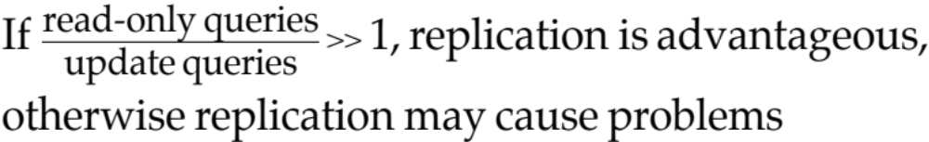
Allocation Alternatives
Non-replicated
  partitioned : each fragment resides at only one site
Replicated
  fully replicated : each fragment at each site
  partially replicated : each fragment at some of the sites
Rule of thumb:

Slide 19
Degree of Fragmentation
finite number of alternatives
tuples
or
attributes
relations
Finding the suitable level of partitioning within this range

Slide 20
Correctness of Fragmentation
Completeness
  Decomposition of relation R into fragments R₁, R₂, ..., R_{n} is complete if and only if each data item in R can also be found in some R_{i}
Reconstruction
  If relation R is decomposed into fragments R₁, R₂, ..., R_{n}, then there should exist some relational operator ∇ such that
        R = ∇_{1≤i≤n}R_{i}
Disjointness
  If relation R is decomposed into fragments R₁, R₂, ..., R_{n}, and data item d_{i} is in R_{j}, then d_{i} should not be in any other fragment R_{k} (k ≠ j ).

Slide 21
How do we get completeness and disjointness?
(1) Check it “manually”!
e.g., F1 = σ sal<10 E ; F2 = σ sal≥10 E

Slide 22
How do we get completeness and disjointness?
(2) “Automatically” generate fragments
with these properties
Desired simple predicates ⇒ Fragments

Slide 23
Predicates
Simple predicates:
Given R[A₁, A₂, …, A_{n}], a simple predicate p_{j} is
p_{j} : A_{i} θ Value where θ ∈ {=,<,≤,>,≥,≠}, Value ∈ D_{i} and D_{i} is the domain of A_{i}.
  For relation R we define Pr = {p₁, p₂, …,p_{m}}
  Example :
      PNAME = "Maintenance"
      BUDGET ≤ 200000
Minterm predicates : Given R and Pr = {p₁, p₂, …,p_{m}}
  define M = {m₁,m₂,…,m_{r}} as
  M = { m_{i} | m_{i} = ∧_{pj∈Pr} p_{j}* }, 1≤j≤m, 1≤i≤z
  where p_{j}* = p_{j} or p_{j}* = ¬(p_{j}).

Slide 24
PHF – Information Requirements
Example
  m₁: PNAME="Maintenance" ∧ BUDGET≤200000
  m₂: NOT(PNAME="Maintenance") ∧ BUDGET≤200000
  m₃: PNAME= "Maintenance" ∧ NOT(BUDGET≤200000)
  m₄: NOT(PNAME="Maintenance") ∧ NOT(BUDGET≤200000)

Slide 25
Example of generation
Say queries use predicates:
  A<10, A>5, Loc = SA, Loc = SB
Next: - generate “minterm” predicates
  - eliminate useless ones
Employee relation E (#,name,loc,sal,A,…)
Integer Value
SA
SB

Slide 26
Minterm predicates (part I)
(1) A<10 ∧ A>5 ∧ Loc=SA ∧ Loc=SB
(2) A<10 ∧ A>5 ∧ Loc=SA ∧ ¬(Loc=SB)
(3) A<10 ∧ A>5 ∧ ¬(Loc=SA) ∧ Loc=SB
(4) A<10 ∧ A>5 ∧ ¬(Loc=SA) ∧ ¬(Loc=SB)
(5) A<10 ∧ ¬(A>5) ∧ Loc=SA ∧ Loc=SB
(6) A<10 ∧ ¬(A>5) ∧ Loc=SA ∧ ¬(Loc=SB)
(7) A<10 ∧ ¬(A>5) ∧ ¬(Loc=SA) ∧ Loc=SB
(8) A<10 ∧ ¬(A>5) ∧ ¬(Loc=SA) ∧ ¬(Loc=SB)

Slide 27
Minterm predicates (part I)
(1) A<10 ∧ A>5 ∧ Loc=SA ∧ Loc=SB
(2) A<10 ∧ A>5 ∧ Loc=SA ∧ ¬(Loc=SB)
(3) A<10 ∧ A>5 ∧ ¬(Loc=SA) ∧ Loc=SB
(4) A<10 ∧ A>5 ∧ ¬(Loc=SA) ∧ ¬(Loc=SB)
(5) A<10 ∧ ¬(A>5) ∧ Loc=SA ∧ Loc=SB
(6) A<10 ∧ ¬(A>5) ∧ Loc=SA ∧ ¬(Loc=SB)
(7) A<10 ∧ ¬(A>5) ∧ ¬(Loc=SA) ∧ Loc=SB
(8) A<10 ∧ ¬(A>5) ∧ ¬(Loc=SA) ∧ ¬(Loc=SB)

Slide 28
Minterm predicates (part I)
5 < A < 10
(1) A<10 ∧ A>5 ∧ Loc=SA ∧ Loc=SB
(2) A<10 ∧ A>5 ∧ Loc=SA ∧ ¬(Loc=SB)
(3) A<10 ∧ A>5 ∧ ¬(Loc=SA) ∧ Loc=SB
(4) A<10 ∧ A>5 ∧ ¬(Loc=SA) ∧ ¬(Loc=SB)
(5) A<10 ∧ ¬(A>5) ∧ Loc=SA ∧ Loc=SB
(6) A<10 ∧ ¬(A>5) ∧ Loc=SA ∧ ¬(Loc=SB)
(7) A<10 ∧ ¬(A>5) ∧ ¬(Loc=SA) ∧ Loc=SB
(8) A<10 ∧ ¬(A>5) ∧ ¬(Loc=SA) ∧ ¬(Loc=SB)
A ≤ 5

Slide 29
Minterm predicates (part II)
(9) ¬(A<10) ∧ A>5 ∧ Loc=SA ∧ Loc=SB
(10) ¬(A<10) ∧ A>5 ∧ Loc=SA ∧¬(Loc=SB)
(11) ¬(A<10) ∧ A>5 ∧¬(Loc=SA) ∧ Loc=SB
(12) ¬(A<10) ∧ A>5 ∧¬(Loc=SA) ∧¬(Loc=SB)
(13) ¬(A<10) ∧¬(A>5) ∧ Loc=SA ∧ Loc=SB
(14) ¬(A<10) ∧¬(A>5) ∧ Loc=SA ∧¬(Loc=SB)
(15) ¬(A<10) ∧¬(A>5) ∧¬(Loc=SA) ∧ Loc=SB
(16) ¬(A<10) ∧¬(A>5) ∧¬(Loc=SA) ∧¬(Loc=SB)

Slide 30
Minterm predicates (part II)
(9) ¬(A<10) ∧ A>5 ∧ Loc=SA ∧ Loc=SB
(10) ¬(A<10) ∧ A>5 ∧ Loc=SA ∧¬(Loc=SB)
(11) ¬(A<10) ∧ A>5 ∧¬(Loc=SA) ∧ Loc=SB
(12) ¬(A<10) ∧ A>5 ∧¬(Loc=SA) ∧¬(Loc=SB)
(13) ¬(A<10) ∧¬(A>5) ∧ Loc=SA ∧ Loc=SB
(14) ¬(A<10) ∧¬(A>5) ∧ Loc=SA ∧¬(Loc=SB)
(15) ¬(A<10) ∧¬(A>5) ∧¬(Loc=SA) ∧ Loc=SB
(16) ¬(A<10) ∧¬(A>5) ∧¬(Loc=SA) ∧¬(Loc=SB)
A ≥ 10

Slide 31
Final fragments:
F2: 5 < A < 10 ∧ Loc=SA
F3: 5 < A < 10 ∧ Loc=SB
F6: A ≤ 5 ∧ Loc=SA
F7: A ≤ 5 ∧ Loc=SB
F10: A ≥ 10 ∧ Loc=SA
F11: A ≥ 10 ∧ Loc=SB

Slide 32
Primary Horizontal Fragmentation
Definition :
      R_{j} = σ_{Fj}(R), 1 ≤ j ≤ w
  where F_{j} is a selection formula, which is (preferably) a minterm predicate.
Therefore,
  A horizontal fragment R_{i} of relation R consists of all the tuples of R which satisfy a minterm predicate m_{i}.
⬇
  Given a set of minterm predicates M, there are as many horizontal fragments of relation R as there are minterm predicates.
  Set of horizontal fragments also referred to as minterm fragments.

Slide 33
Correctness of Fragmentation
Completeness
  Decomposition of relation R into fragments R₁, R₂, ..., R_{n} is complete if and only if each data item in R can also be found in some R_{i}
Reconstruction
  If relation R is decomposed into fragments R₁, R₂, ..., R_{n}, then there should exist some relational operator ∇ such that
        R = ∇_{1≤i≤n}R_{i}
Disjointness
  If relation R is decomposed into fragments R₁, R₂, ..., R_{n}, and data item d_{i} is in R_{j}, then d_{i} should not be in any other fragment R_{k} (k ≠ j ).

Slide 34
Primary Horizontal Fragmentation
Definition :
      R_{j} = σ_{Fj}(R), 1 ≤ j ≤ w
  where F_{j} is a selection formula, which is (preferably) a minterm predicate.
Therefore,
  A horizontal fragment R_{i} of relation R consists of all the tuples of R which satisfy a minterm predicate m_{i}.
⬇
  Given a set of minterm predicates M, there are as many horizontal fragments of relation R as there are minterm predicates.
  Set of horizontal fragments also referred to as minterm fragments.

Slide 35
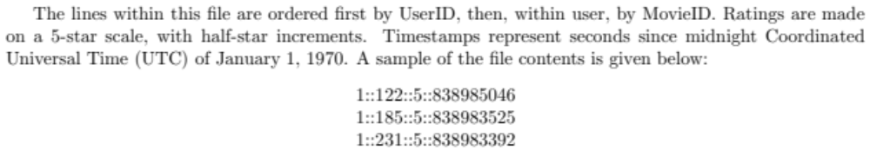
Assignment 1
Fragmentation

Slide 36
Horizontal Fragmentation
Range
Round Robin
A...E
F...J
K...N
O...S
T...Z
A...E
F...J
K...N
O...S
T...Z
Notes:
77

Slide 37
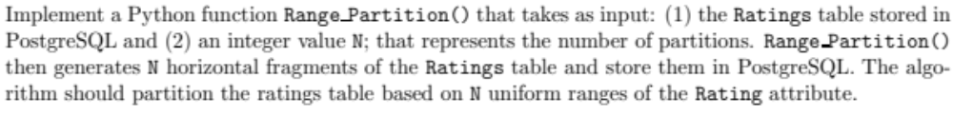
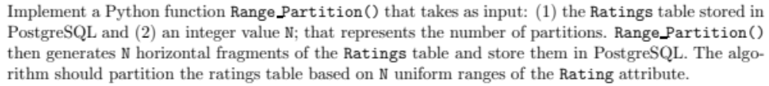

Slide 38
Derived Horizontal Fragmentation
Defined on a member relation of a link according to a selection operation specified on its owner.
  Each link is an equijoin.
Pay
TITLE,
SAL
L₁
EMP
PROJ
ENO, ENAME, TITLE
PNO, PNAME, BUDGET, LOC
L₂
L₃
ASG
ENO, PNO,
RESP, DUR

Slide 39
DHF – Definition
Given a link L where owner(L)=S and member(L)=R, the derived horizontal fragments of R are defined as
  R_{i} = R ⋉_{F} S_{i}, 1≤i≤w
where w is the maximum number of fragments that will be defined on R and
    S_{i} = σ_{Fi} (S)
where F_{i} is the formula according to which the primary horizontal fragment S_{i} is defined.

Slide 40
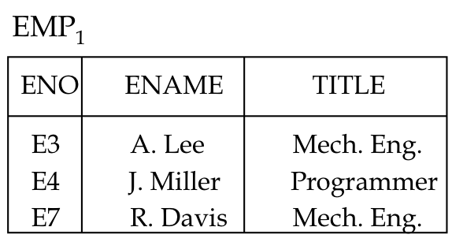
DHF – Example
Given link L₁ where owner(L₁)=PAY and member(L₁)=EMP
    EMP₁ = EMP ⋉ PAY₁
    EMP₂ = EMP ⋉ PAY₂
Where
    PAY₁ = σ_{SAL≤30000}(PAY)
    PAY₂ = σ_{SAL>30000}(PAY)
EMP₂
ENO
ENAME
TITLE
E1
J. Doe
Elect. Eng.
E2
M. Smith
Syst. Anal.
E5
B. Casey
Syst. Anal.
E6
L. Chu
Elect. Eng.
E8
J. Jones
Syst. Anal.

Slide 41
How to achieve Completeness and Disjointness?

Slide 42
To get
completeness
Need to enforce
referential integrity constraint:
join attr(#) of member relation
⇓
joint attr(#) of owner relation

Slide 43
To get
disjointness
Join attribute(#) should be
key of owner relation

Slide 44
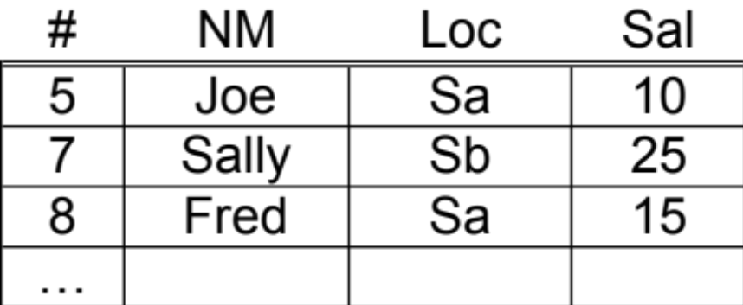
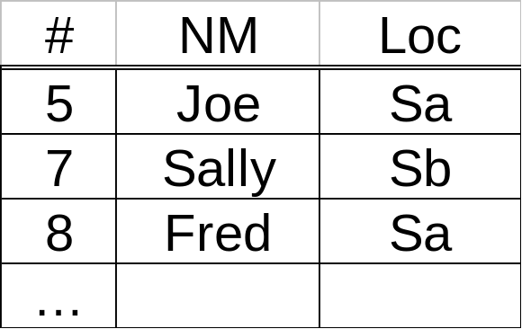
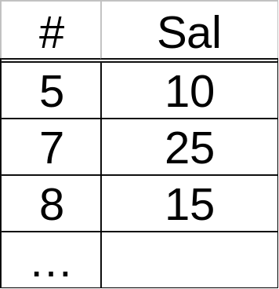
Vertical fragmentation
E
Example:
E1
E2

Slide 45
Vertical Fragmentation
More difficult than horizontal, because more alternatives exist.
Two approaches :
  grouping
    attributes to fragments
  splitting
    relation to fragments

Slide 46
Properties: R[T] ⇒ Ri[Ti]
(1) Completeness
U Ti = T
all i

Slide 47
(2) Disjointness
Ti ∩ Tj = ∅ for all i,j i≠j
E(#,LOC,SAL)
E1(#,LOC)
E2(SAL)

Slide 48
Ti ∩ Tj = ∅ for all i,j i≠j
E(#,LOC,SAL)
E1(#,LOC)
E2(SAL)
Not a desirable property!!
(could not reconstruct R!)

Slide 49
(3) Lossless join
Ri = R
all i
 One way to achieve lossless join:
Repeat key in all fragments, i.e.,
Key ⊆ Ti for all i

Slide 50
VF – Information Requirements
Application Information
  Attribute affinities
    a measure that indicates how closely related the attributes are
    This is obtained from more primitive usage data
  Attribute usage values
    Given a set of queries Q = {q₁, q₂,…, q_{q}} that will run on the relation R[A₁, A₂,…, A_{n}],\
    use(q_{i},•) can be defined accordingly
⎧
1 if attribute A_{j} is referenced by query q_{i}
use(q_{i},A_{j}) =
⎨
⎩
0 otherwise

Slide 51
VF – Definition of use(q_{i},A_{j})
Consider the following 4 queries for relation PROJ
q₁: SELECT BUDGET q₂: SELECT PNAME,BUDGET
FROM PROJ FROM PROJ
WHERE PNO=Value
q₃: SELECT PNAME q₄: SELECT SUM(BUDGET)
FROM PROJ FROM PROJ
WHERE LOC=Value WHERE LOC=Value
Let A₁= PNO, A₂= PNAME, A₃= BUDGET, A₄= LOC
A₁
A₂
A₃
A₄
q₁
1
0
1
0
q₂
0
1
1
0
Attribute Usage Matrix
q₃
0
1
0
1
q₄
0
0
1
1

Slide 52
VF – Affinity Measure aff(A_{i},A_{j})
The attribute affinity measure between two attributes A_{i} and A_{j} of a relation R[A₁, A₂, …, A_{n}] with respect to the set of applications Q = (q₁, q₂, …, q_{q}) is defined as follows :
∑
aff (A_{i}, A_{j}) =
(query access)
all queries that access A_{i} and A_{j}
∑
access
query access =
access frequency of a query ∗
execution
all sites

Slide 53
Attribute affinity matrix
A1 A2 A3 A4 A5
A1 - - - - -
A2 50 - - - -
A3 45 48 - - -
A4 1 2 0 - -
A5 0 0 4 75 -
R1[K,A1,A2,A3] R2[K,A4,A5]
Notes:
Partitioning and Clustering

Slide 54
Hybrid Fragmentation
R
HF
HF
R₁
R₂
VF
VF
VF
VF
VF
R₁₁
R₁₂
R₂₁
R₂₂
R₂₃

Slide 55
Fragment Allocation
Problem Statement
  Given
      F = {F₁, F₂, …, F_{n}} fragments
      S ={S₁, S₂, …, S_{m}} network sites
      Q = {q₁, q₂,…, q_{q}} applications
  Find the "optimal" distribution of F to S.
Optimality
  Minimal cost
    Communication + storage + processing (read & update)
    Cost in terms of time (usually)
  Performance
    Response time and/or throughput
  Constraints
    Per site constraints (storage & processing)

Slide 56
Issues
Where do queries originate
What is communication cost? and size of answers, relations,…
What is storage capacity, cost at sites? and size of fragments?
What is processing power at sites?

Slide 57
Do we replicate fragments?

Slide 58
Why Replication ?
When does it become challenging?

Slide 59
Why Replication?
Gives increased availability.
Faster query evaluation.
Updates are Challenging

Slide 60
Potentially Improved Performance
Proximity of data to its points of use
  Requires some support for fragmentation and replication

Slide 61
Optimization problem
What is best placement of fragments and/or best number of copies to:
  minimize query response time
  maximize throughput
  minimize “some cost”
  ...
Subject to constraints?
  Available storage
  Available bandwidth, power,…
  Keep 90% of response time below X
  ...

Slide 62
Questions

Slide 63
Project
Start Playing with Apache Spark.
Download it – run the examples
Phase 1 requirements will be announced soon.

